Slide 1
Cosmology

Slide 2
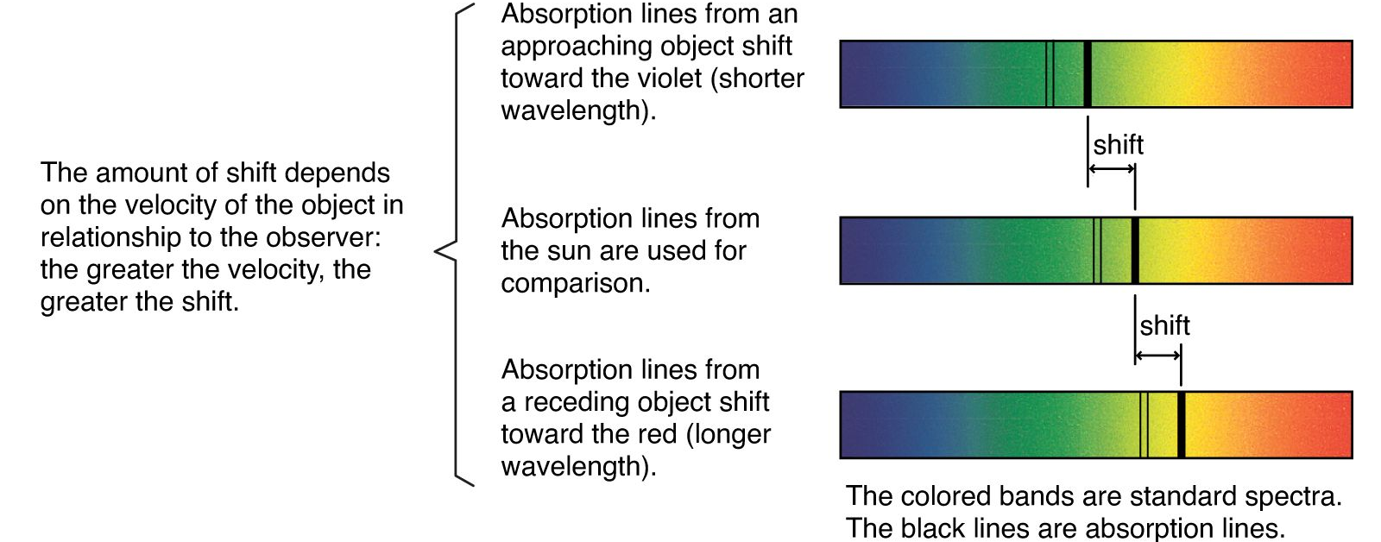
Redshift
Just like sound, light is subject to the Doppler effect: an apparent change in frequency caused by the motion of the source relative to the observer.
With sound, this is commonly observed as a change in pitch, but with light:
Light from a source that is receding (moving away) appears redder – this is called redshift.
Light from a source that is approaching appears bluer – this is called blueshift.

Slide 3
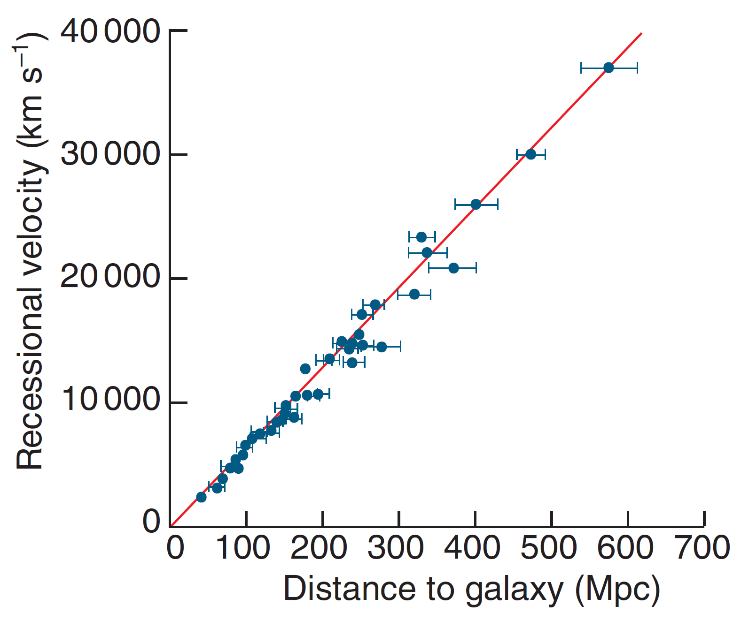
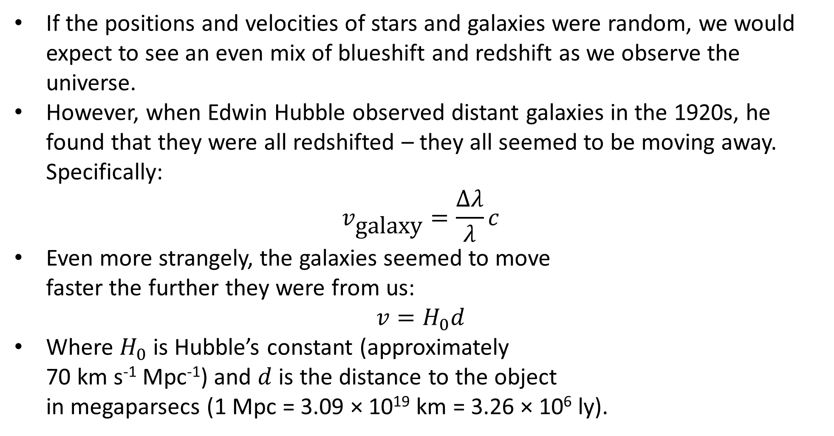
Hubble’s Law
If the positions and velocities of stars and galaxies were random, we would expect to see an even mix of blueshift and redshift as we observe the universe.
However, when Edwin Hubble observed distant galaxies in the 1920s, he found that they were all redshifted – they all seemed to be moving away. Specifically:
$$v_{\text{galaxy}}=\frac{Δλ}{λ}c$$
Even more strangely, the galaxies seemed to move faster the further they were from us:
$$v=H_{0}d$$
Where $H_{0}$ is Hubble’s constant (approximately 70 km s⁻¹ Mpc⁻¹) and $d$ is the distance to the object in megaparsecs (1 Mpc = 3.09 × 10¹⁹ km = 3.26 × 10⁶ ly).
Notes:
Be careful – by default, Hubble’s law gives velocities in km s⁻¹, not m s⁻¹.
Calculating Hubble’s constant requires a lot of assumptions, and the accuracy of the data we use is limited due to the enormous distances involved.

Slide 4
Interpreting Hubble’s Law
This phenomenon was difficult to explain simply:
If everything is exploding away from us, why isn’t everything moving at the same speed?
If everything is exploding away from some distant ‘centre’ of the universe, why do we observe a linear relationship in all directions?
The conclusion that best fit the evidence was that space itself was expanding.
This is often described using the raisin bread analogy: just as the rising of raisin bread increases the distances between all of the raisins (with further ones being affected more), so the expansion of space causes all of the galaxies to move away from each other.

Slide 5
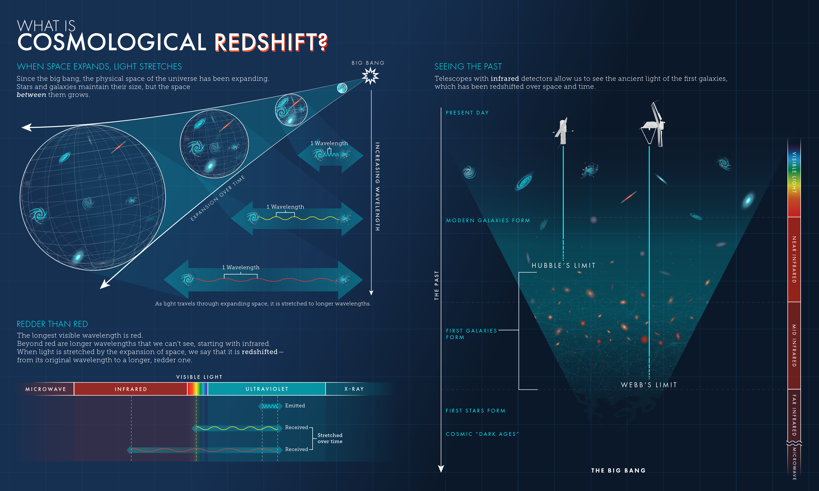
Interpreting Hubble’s Law
This expansion of space implies that much of the redshift we observe is caused by the expansion of the very space the light is travelling through!
This is known as cosmological redshift, and is the dominant source of redshift for distant galaxies.
Since closer galaxies are affected less by the expansion of space, their velocities (known as peculiar velocities) make more significant contributions to the Doppler effect, sometimes resulting in blueshift.

Slide 6
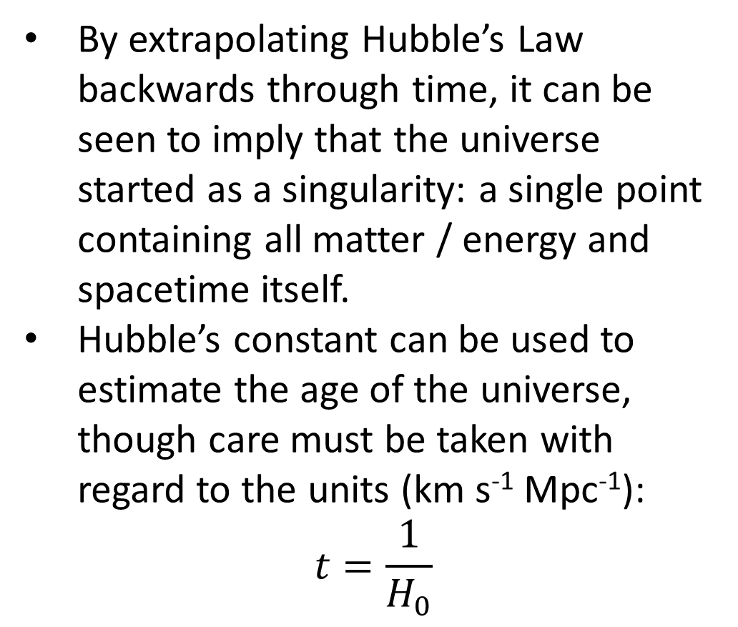
Interpreting Hubble’s Law
By extrapolating Hubble’s Law backwards through time, it can be seen to imply that the universe started as a singularity: a single point containing all matter / energy and spacetime itself.
Hubble’s constant can be used to estimate the age of the universe, though care must be taken with regard to the units (km s⁻¹ Mpc⁻¹):
$$t=\frac{1}{H_{0}}$$

Slide 7
Objections to Hubble’s Law
Though Hubble’s work explained the evidence well, the Big Bang theory was not universally accepted (in fact, its name was invented by one of its opponents, who was mocking its absurdity).
To complete the worksheet, you will need to research:
Steady state theory, which was an alternative to the big bang theory
Cosmic microwave background radiation, a discovery that disproved steady state theory

